Slide 1
Farmer’s League
By Daniel Gross and Owen Handelman

Slide 2

Background
Farmer’s league - football league where players are semi-professional
Used as an insult, to claim a league is easy to win

Slide 3
Methodology
Number of different champions, teams to finish in the top six
Margin of champion’s points to second place, adjusted for number of teams
Domination Percentage - amount of total available points team achieved
Top Five Threepeat - the number of teams that are in the top five in each of the three seasons in question (the season with the statistic, and the two seasons before) (if Barcelona got 2nd, 4th, and 1st that would be one)
Top Three Threepeat - the same methodology as Top Five Threepeat but only looking at the top three teams
Back-to-Back - if the previous season’s champion was the same as the current champion then the current season counts as a Back-to-Back season, this does not count the previous season as one

Slide 4
Data
Major leagues with significant dataset
Top 5 european leagues + Portugal and Netherlands
1963 - latest beginning year for a league dataset
Data acquired through web scraping in python with Requests + BeautifulSoup
League facts sourced from Wikipedia

Slide 5
England
EFL Founded 1888 (oldest football league in the world)
Teams from England + Wales competed in EFL until 1992, when Premier League was formed
20 teams
Current Champions: Manchester City
Notable teams: Tottenham, Manchester United, Liverpool, Chelsea
Brexit football and spending money

Slide 6
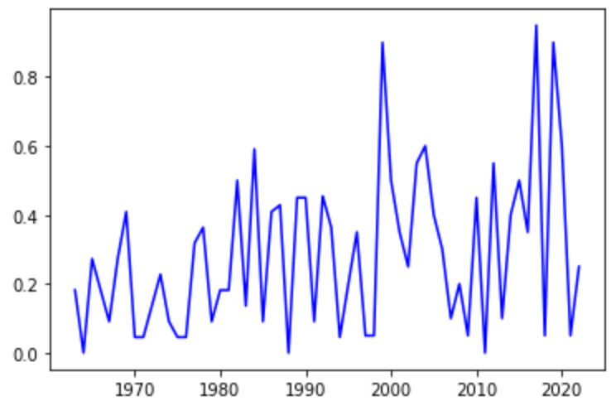
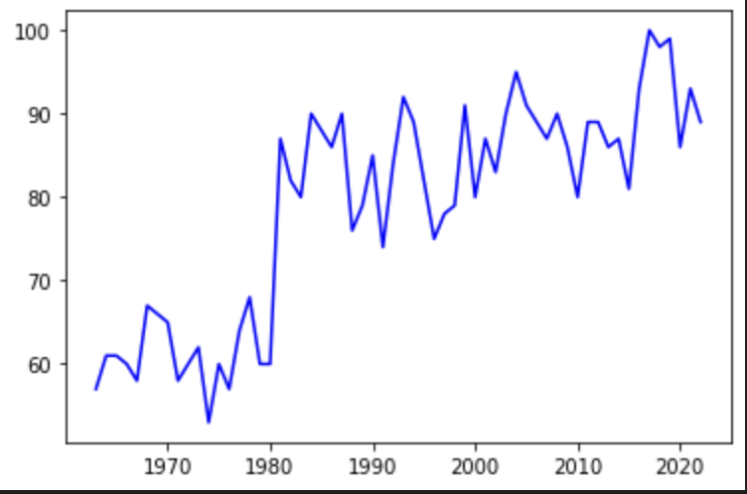
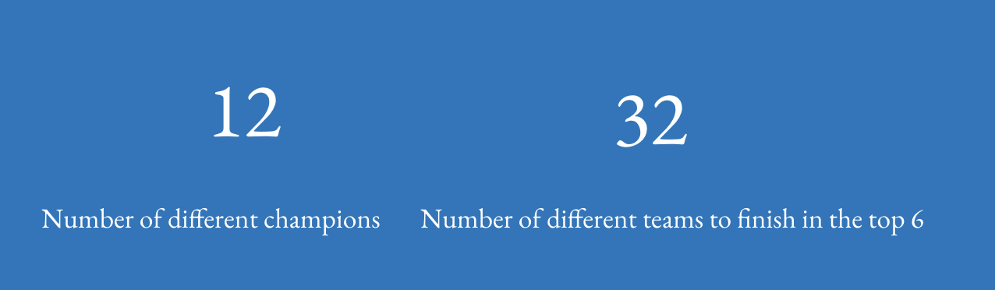
England
Adjusted Champion Margin
Champion points per season

Slide 7
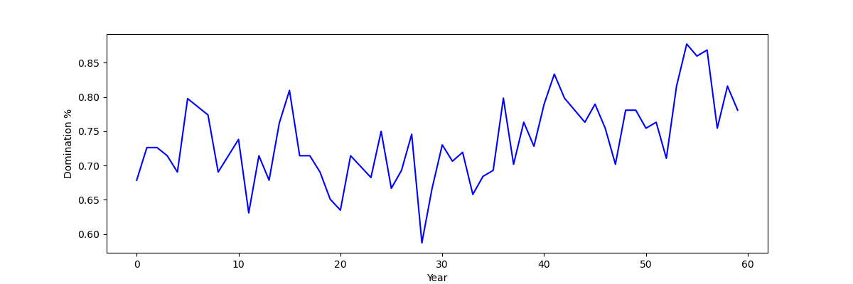
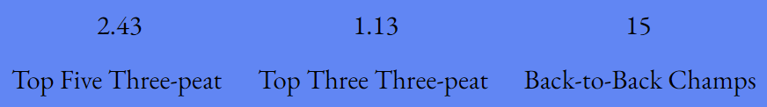
England

Slide 8
France
Founded in 1932 as National, changed to Division 1 in 1933
In 2002, named changed to Ligue 1, current official name is Ligue 1 UberEats
18 (including 1 from Monaco)
Current champions: Paris Saint-Germain
Notable teams: Monaco, Marseille, Lyon, LOSC Lille
Mbappe

Slide 9
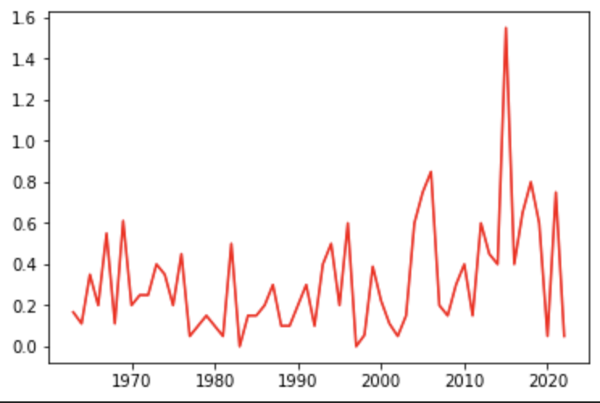
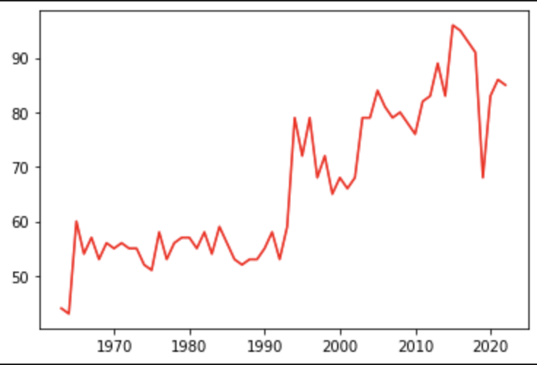
France
Adjusted Champion Margin
Champion points per season

Slide 10
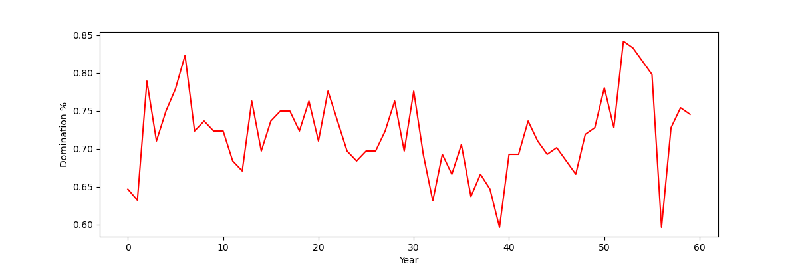

France

Slide 11
Germany
Bundesliga founded 1963
Best average attendance in the football world
Began as West German league before reunification in 1990
18 teams
Current Champions: Bayern Munich (11 times in a row)
(But, Bayer Leverkusen just clinched this year’s championship…)
Notable teams: Borussia Dortmund, VFB Stuttgart, Schalke 04
Beer and Tifos

Slide 12
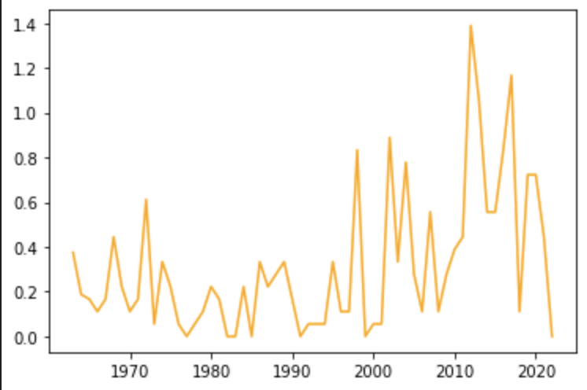
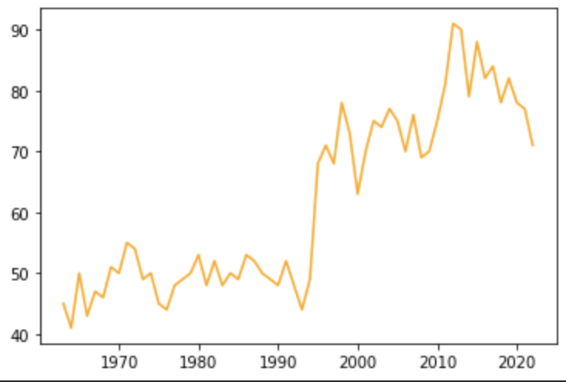
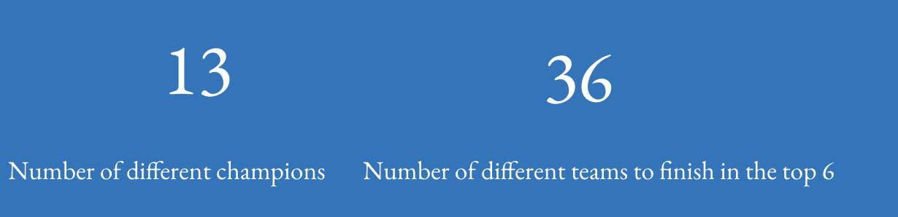
Germany
Adjusted Champion Margin
Champion points per season

Slide 13
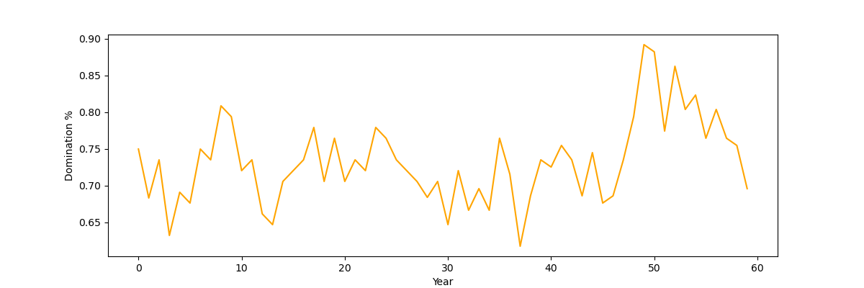
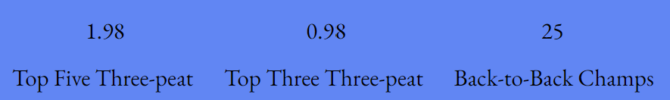
Germany

Slide 14
Italy
Serie A founded in 1898 with regional championships, modern format established in 1929
20 teams
Current Champions: Napoli
Notable teams: Juventus, AC Milan, Inter Milan, Roma
Ultras and corruption

Slide 15
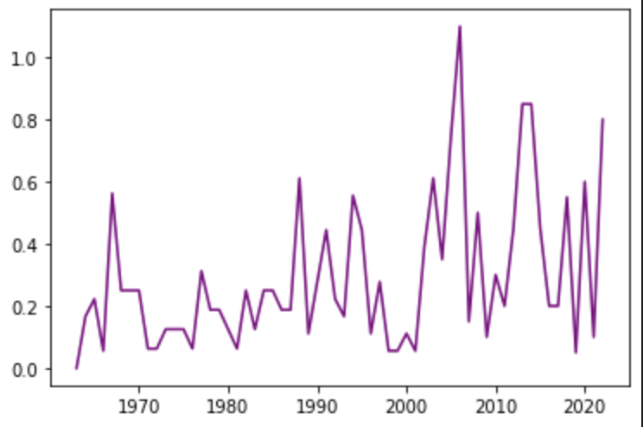
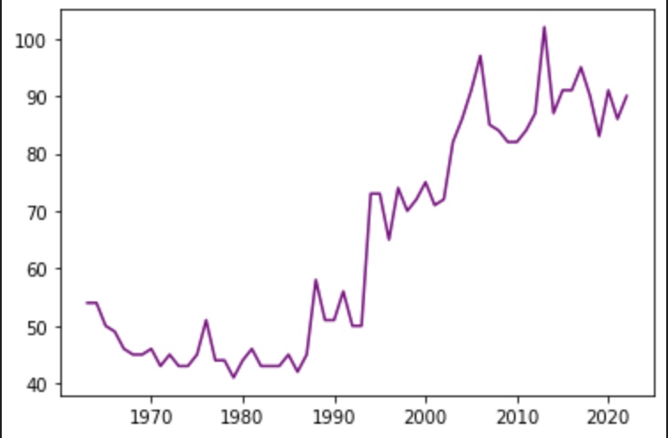
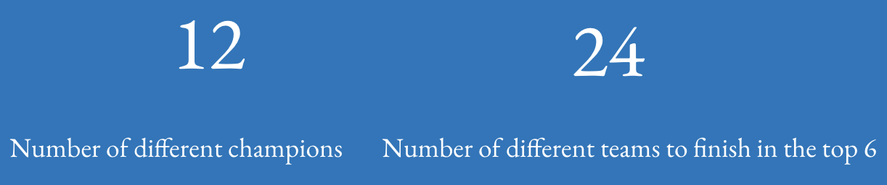
Italy
Adjusted Champion Margin
Champion points per season

Slide 16
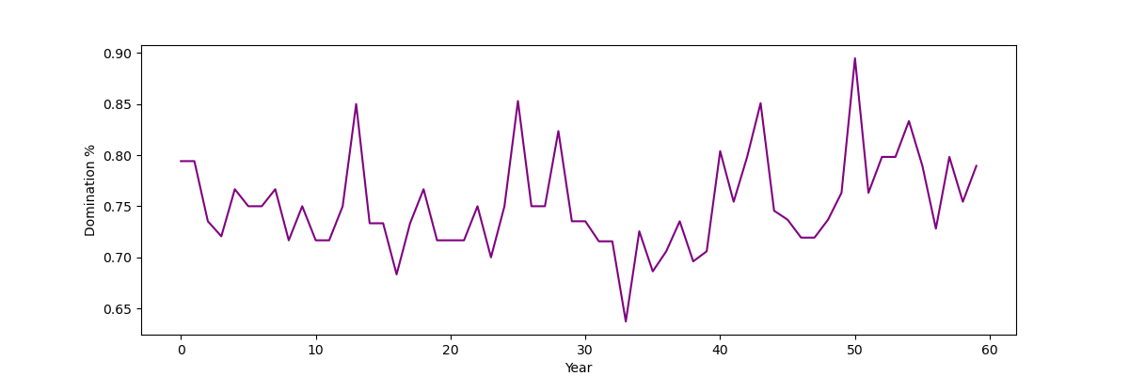

Italy

Slide 17
Netherlands
Eredivisie founded 1956
First professional league in the Netherlands
18 teams
Current Champions: Feyenoord
Notable teams: Ajax, PSV Eindhoven
Three teams listed here account for 66/69 league championships
Young talents

Slide 18
Netherlands
Adjusted Champion Margin
Champion points per season

Slide 19
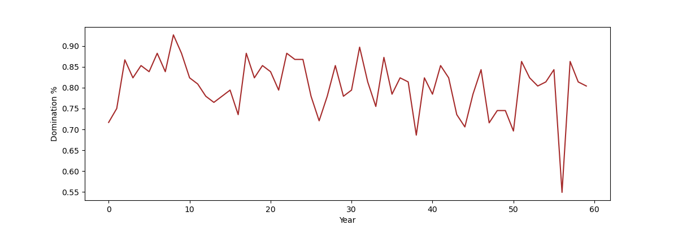
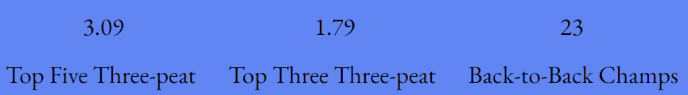
Netherlands

Slide 20
Portugal
Founded in 1934 as Campeonato de Liga da Primeira Divisão and changed to Campeonato Nacional da Primeira Divisão in 1938
Name changed to Primeira Liga (Liga Portugal) in 1999
18 clubs from across Portugal but concentrated around Lisbon and in the north of Portugal
Current Champions: Benfica
Big Three Teams: Benfica, Porto, Sporting CP
The big three have won 87/89 league championships
The big three have created an interesting culture that has sapped supporters from local clubs

Slide 21
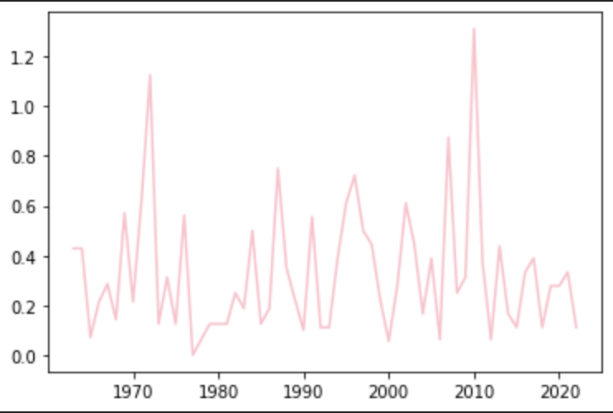
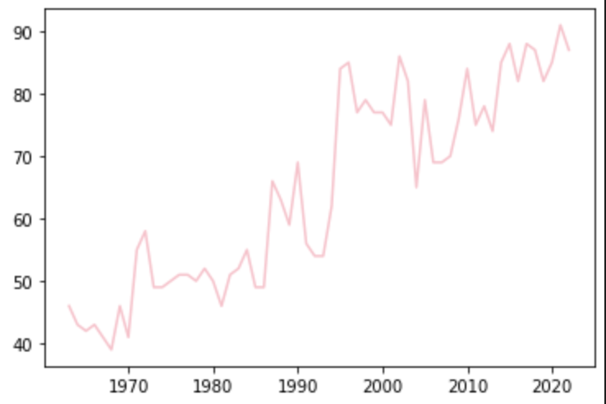
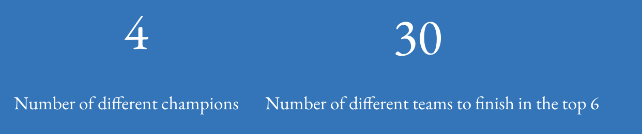
Portugal
Adjusted Champion Margin
Champion points per season

Slide 22
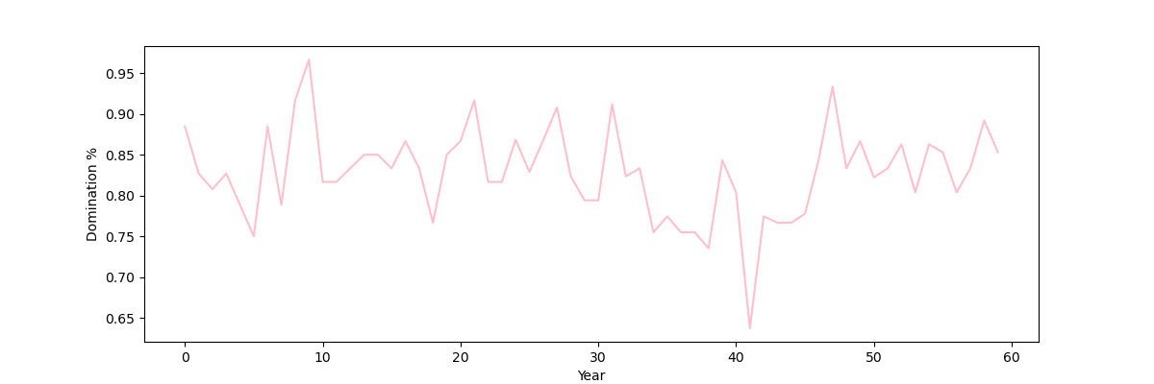

Portugal

Slide 23
Spain
Founded in 1929 as Campeonato Nacional de Liga de Primera División but is commonly referred to as La Liga (La Liga EA Sports since 2023)
20 clubs from across Spain compete
Current Champions: Barcelona
Notable Teams: Barcelona, Real Madrid, Atlético Madrid, Athletic Bilbao
Galacticos

Slide 24
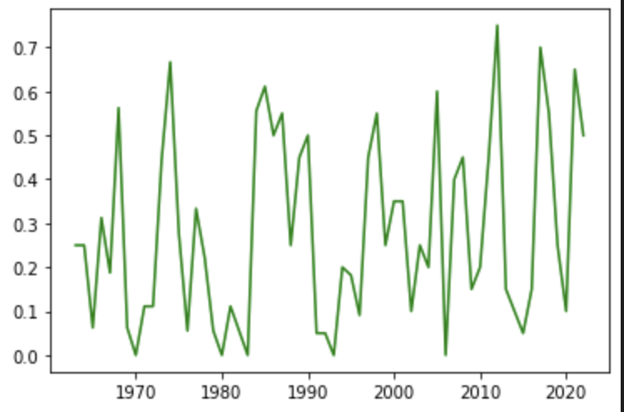
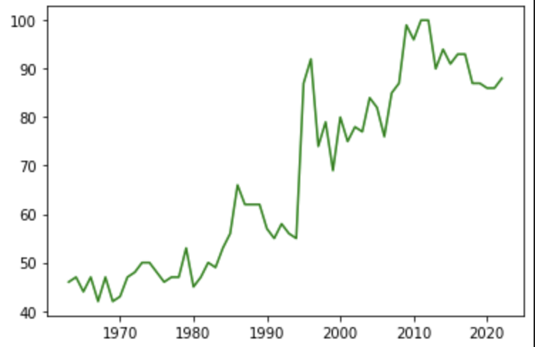
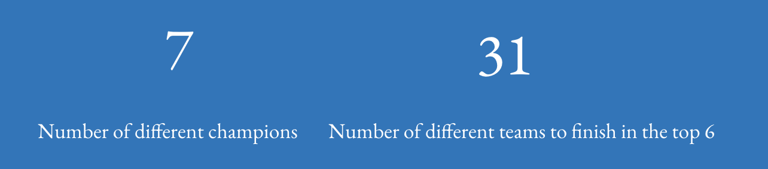
Spain
Adjusted Champion Margin
Champion points per season

Slide 25
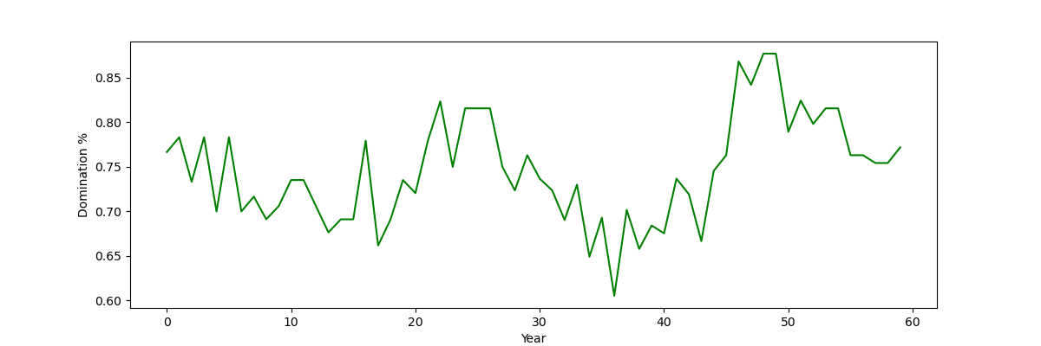

Spain

Slide 26
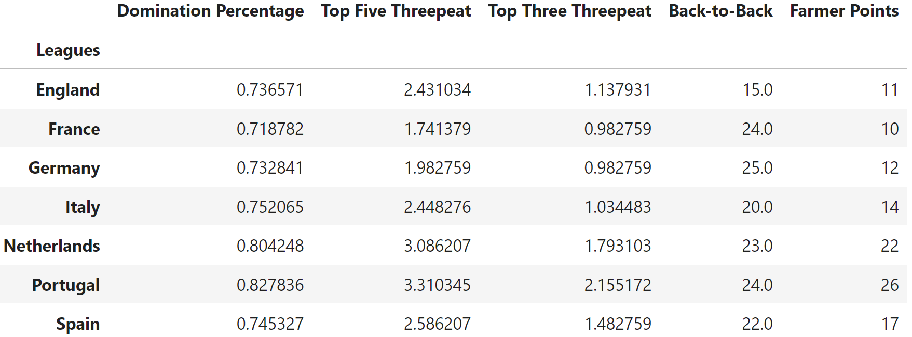
Owen’s Conclusion for the last 60 years
The above data table was created by averaging (for the 60 years of data) all the statistics other than Back-to-Back (which was totaled) for each league.
To rank the leagues across these statistics an additional stat was created, Farmer Points, where each league gets points based on how their statistic relates to every other league. In this case 7 points for having the highest in each
category as a higher value in each category implies less over-all competition. For example Portugal got 7 points for having the highest average Domination Percentage while France got 1 point for having the lowest. Instances of two leagues tying in a stat lead to the league with the otherwise lower score getting the higher point value.
Looking at the Farmer Point rankings we get the ranking of most farmer to least farmer of the leagues as: Portugal, Netherlands, Spain, Italy, Germany, England, France

Slide 27
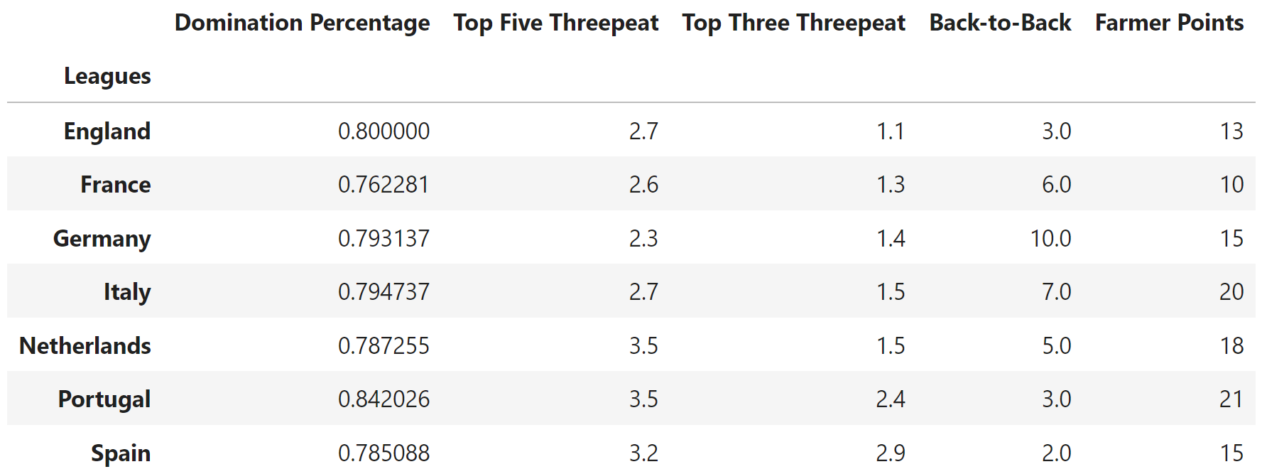
Owen’s Conclusion for the last 10 years
Using the same methodology but for the last ten years, the ranking of leagues changes. The new list from most farmer to least is: France, England, Germany, Spain, Netherlands, Portugal, Italy
Of note is how the range of Farmer Points decreased from 15 to 10, without the lowest score increasing and only the highest significantly decreasing by 5 points from 26 to 21
Interestingly, France, which is commonly considered to be the farmer’s league, is in both analysis considered to be the most competitive. Part of the reason why this may be the case is that while PSG’s recent dominance domestically is not that unique, and competition for the remaining top spots is much more fierce and less controlled.

Slide 28
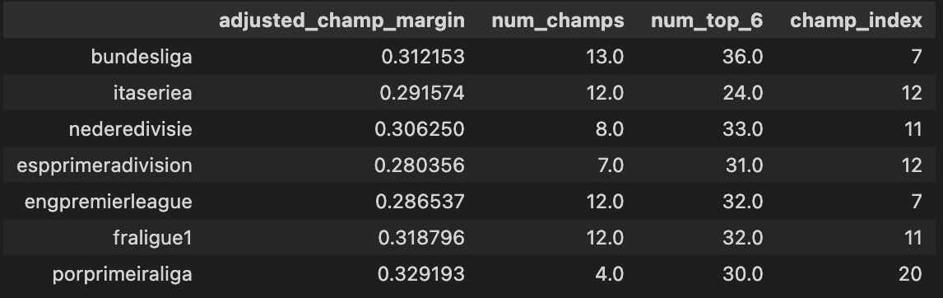
Daniel’s Conclusion
The data in this table from 60 year averages of key statistics
Champ index score is similar to Owen’s ‘farmer points’ system, lower points == higher ranked
Both Bundesliga and Premier League perform well, Portuguese league lags far behind.
Surprisingly, French and Dutch leagues are ahead of Italian and Spanish leagues.
As with Owen’s analysis, Portuguese Liga NOS is a Farmer’s league per this analysis
Unlike Owen’s analysis, French Ligue 1 was not the highest ranked.

Slide 29
3.31
2.16
24
Top Five Three-peat
Top Three Three-peat
Back-to-Back Champs

Slide 30
7
31
Number of different champions
Number of different teams to finish in the top 6

